Slide 1
Smart agriculture system
Internet of things
Submitted By:- Anshika Goel
Project ID:- SPS_PRO_101

Slide 2
PROJECT DESCRIPTION
Can monitor soil moisture and climatic conditions to grow and yield a good crop.
The farmer can also get the real time weather forecasting data.
Farmer is provided a mobile app using which he can monitor the temperature, humidity and soil moisture parameters along with weather forecasting details.
Based on all the parameters he can water his crop by controlling the motors using the mobile application.
Even if the farmer is not present near his crop he can water his crop by controlling the motors using the mobile application from anywhere.
The Online IoT simulator is used for getting the temperature, humidity and soil moisture values.

Slide 3
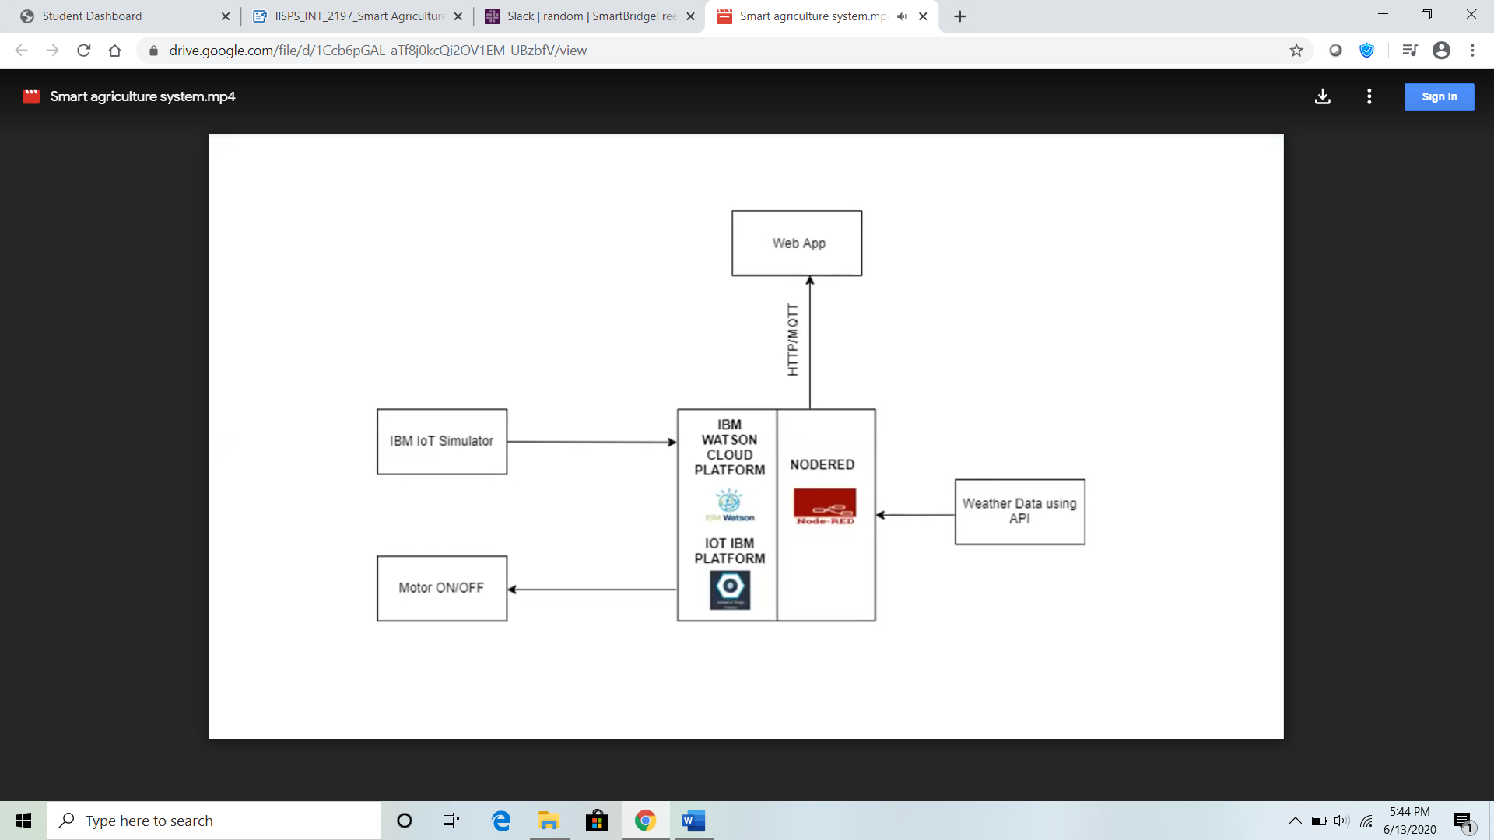

Slide 4
FUTURE SCOPE
IoT sensors capable of providing farmers with information about crop yields, rainfall, pest infestation, and soil nutrition are invaluable to production and offer precise data which can be used to improve farming techniques over time.
Conservation of electricity and water. The automated system allows farmer to control water pumps from anywhere which ensures limited use of water.
With accurate data provided by the app a farmer can increase crop yield, thereby increasing profit.

Slide 5
THANK YOU

